Slide 1
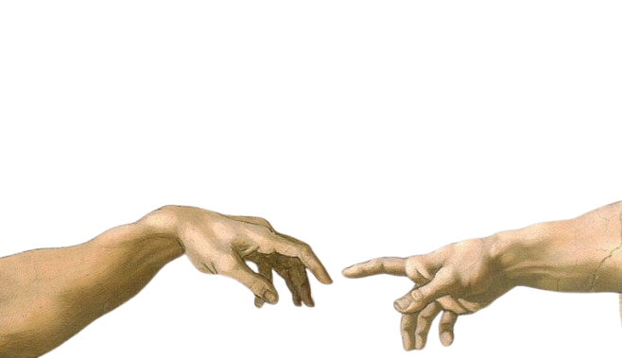


Foundations of Artificial Intelligence (AI)
Peiman Parsa

Slide 2


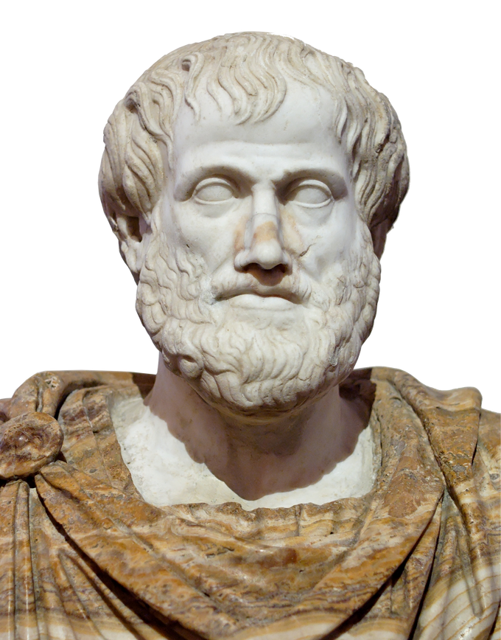
Early Pioneers of AI
Roots of AI:
The idea of Artificial Intelligence (AI) and creating machines that think or behave intelligently dates back centuries. While many contributed to this concept, Alan Turing is often considered the first to formalize AI in a modern sense.
Ancient Philosophers
Aristotle (384–322 BCE): Pioneered formal logic, essential for AI’s reasoning systems. His work on syllogisms influenced symbolic reasoning and knowledge representation in AI.
René Descartes (1596–1650): Proposed that machines could imitate human thought, laying the groundwork for mechanistic views of thought in AI.
Charles Babbage (1791–1871) Known as the “Father of the Computer”, Babbage designed the Analytical Engine, a mechanical computer capable of performing any calculation algorithmically. His ideas were crucial to the development of modern computing and AI.

Slide 3
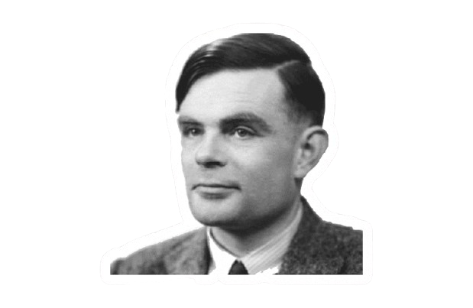

Early Pioneers of AI
Ada Lovelace (1815–1852)
Often called the first computer programmer, Lovelace recognized that Babbage’s machine could perform more than just arithmetic. She speculated that it could one day "think" like a human, laying the conceptual foundation for AI.
Alan Turing (1912–1954)
Turing Machine (1936): Turing formalized AI with the creation of the Turing Machine, a model for computation.
Turing Test (1950): Proposed as a measure of machine intelligence, suggesting a machine could be considered intelligent if it could engage in a conversation indistinguishable from that of a human.
Turing’s Vision: He was the first to propose that machines could simulate all aspects of human intelligence, leading to the birth of modern AI and machine learning.

Slide 4

The Turing Test and Chinese Room
The Turing Test
What Is It?
Proposed by Alan Turing (1950) to test if a machine can imitate human conversation indistinguishably.
Key Idea: Intelligence judged by behavior, not internal processes.
Criticism:
Focuses on imitation, not understanding or consciousness.
Visuals: Diagram of a judge interacting with a human and a computer.
The Chinese Room Argument
Proposed By: John Searle (1980).
Core Idea:
A person in a room follows rules to manipulate symbols without understanding their meaning.
Key Argument: Machines handle syntax but lack semantics (true understanding).
Critiques:
System-level understanding may exist.
Interaction with the world could lead to comprehension.
Visuals: Illustration of a person in a room surrounded by symbols.

Slide 5

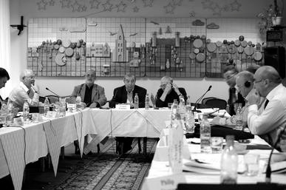


Why AI?
Let’s explore why Artificial Intelligence is one of the most exciting fields in science today!
Did you know that Artificial Intelligence, as a scientific discipline, is younger than most of your grandparents? The term "AI" was coined in 1956 at the Dartmouth Conference, but its roots stretch back much further. Thousands of years ago, humans dreamed of creating machines or beings that could think and reason—imagine the myths of automatons, clockwork knights, and stories like the Golem.

Slide 6

What is Artificial Intelligence?
Definition
Automation of activities associated with human thinking, such as decision-making, learning, and reasoning (Bellman, 1978).
Key Questions
What makes humans intelligent?
Can machines replicate human cognition and behavior?
Discussion Points:
Intelligence vs. Artificial Intelligence.
How AI imitates human abilities.

Slide 7

Intelligence – Definitions
Notable Definitions
Terman (1921): Abstract thinking.
Wechsler (1958): Acting purposefully, rationally, and effectively.
Kurzweil (1999): Using limited resources optimally.
Key Perspectives
Intelligence as adaptation to the environment.
Measurement through tasks or outcomes.

Slide 8

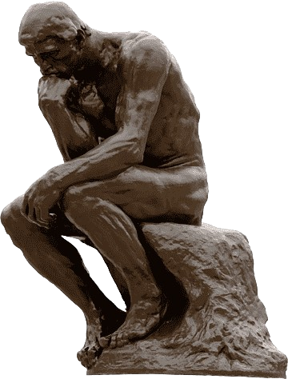
Approaches to AI
Thinking Humanly
Cognitive modeling (psychology, neuroscience).
Techniques: brain imaging, introspection, and experiments.
Acting Humanly
The Turing Test (1950): Can machines mimic human conversation effectively?
Thinking Rationally
“Laws of thought” approach: Inspired by Aristotle’s logic.
Challenges: Converting informal knowledge into formal reasoning.
Acting Rationally
Rational agents: Perceive and act optimally within their environment.
Key Takeaway: Rational agents form the foundation of modern AI systems.

Slide 9


Subareas of Artificial Intelligence
1. Problem Solving
Techniques: Search algorithms, planning methods
AI systems solve complex problems using optimized strategies and planning.
2. Knowledge Representation
Techniques: Logical, probabilistic reasoning
Machines represent knowledge logically and make decisions using reasoning techniques.
3. Learning
Techniques: Supervised, unsupervised, reinforcement learning
Systems learn autonomously from data to improve performance.
4. Perception and Robotics
Techniques: Computer vision, speech recognition, object manipulation
Machines sense and interact with the physical world, like recognizing images and understanding speech.
5. Natural Language Processing (NLP)
Applications: Translation, virtual assistants, chatbots
AI understands and generates human language for applications like translation and virtual assistants.
6. Planning
Techniques: Heuristic methods, optimization
AI systems plan actions and select the best paths to achieve goals.
7. Game Theory
Techniques: Strategic decision-making, multi-agent systems
AI simulates decision-making in competitive or cooperative scenarios.

Slide 10


Subareas of Artificial Intelligence
8. Expert Systems
Techniques: Rule-based systems, inference engines
Systems simulate expert decision-making using predefined rules.
9. Computer Vision
Techniques: Image recognition, face detection
AI interprets visual data like identifying objects and faces.
10. Collective Intelligence
Techniques: Collective behavior, decentralized systems
AI mimics collective behaviors from nature to solve complex problems collaboratively.
11. Emotional Computing
Techniques: Sentiment analysis, emotion detection
AI detects human emotions through voice, facial expressions, and text.
12. Computational Neuroscience
Techniques: Brain-inspired models, neural networks
AI mimics brain processes using neural networks for deep learning.
13. Autonomous Systems
Techniques: Self-navigation, sensor integration
Machines perform tasks independently, like self-driving cars and drones.
14. Cognitive Computing
Techniques: Natural language processing, reasoning
AI simulates human thought processes for smarter decision-making.

Slide 11




Rationality in AI
What is Rationality?
Acting optimally to achieve goals with limited resources.
Mathematical Roots
Derived from logic, utility theory, and game theory.
Challenges
Rationality doesn’t always require conscious thinking (e.g., reflex actions).
Decisions under uncertainty or incomplete information.
Discussion: Explore how rational agents differ from human decision-making

Slide 12




Milestones in AI
1. Timeline Highlights
1943: McCulloch & Pitts introduce the Boolean circuit model of the brain, laying the foundation for neural networks.
1956: The term “Artificial Intelligence” is coined at the Dartmouth Conference, marking AI’s formal birth.
1979: Stanford Cart – the first autonomous vehicle, navigates obstacles.
1980s: Emergence of expert systems, simulating human decision-making.
1997: IBM Deep Blue defeats Garry Kasparov in chess, showcasing AI in strategic thinking.
2011: IBM Watson wins Jeopardy! by processing natural language and vast data.
2016: Google’s AlphaGo beats the world champion in Go, advancing deep learning.
2001–Present: AI is rapidly applied in big data, healthcare, NLP, and robotics.
2. Notable Achievements
NASA’s Autonomous Planning Program: Optimizes spacecraft operations for missions like Mars exploration.
DARPA Grand Challenge: Pioneered autonomous vehicle development through desert navigation challenges.
AI in Medicine: DeepMind’s AlphaFold solves protein folding, revolutionizing biology and drug discovery.
Generative AI (2020s): GPT and DALL-E enable machines to generate text, art, and music, transforming creative industries.

Slide 13


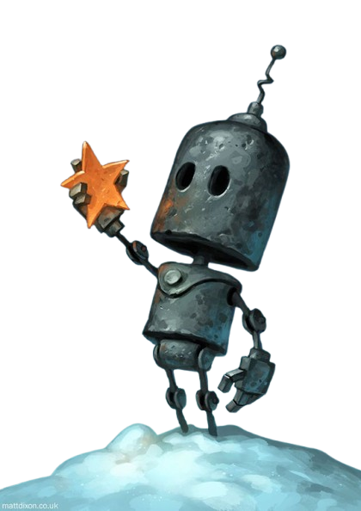

Challenges and Future Directions
1. Challenges
Computational Complexity: AI models require vast computational resources, limiting scalability.
Data Privacy & Security: Protecting personal data used by AI systems is crucial.
Ethical Concerns:
Bias: AI can perpetuate societal biases if trained on biased data.
Transparency: Many AI models operate as "black boxes," making decision processes unclear.
Societal Impact: AI may disrupt jobs and industries, raising concerns about fairness.
Generalization: AI struggles to apply knowledge across different tasks and environments.
2. Future Goals
Human-Level AI: Developing machines that think, learn, and create like humans.
Expanding Applications: AI’s potential in healthcare, environment, and creativity will continue to grow.

Slide 14


Thank You

